Slide 1
Implementing Inter-VLAN Routing
Describing Routing Between VLANs

Slide 2
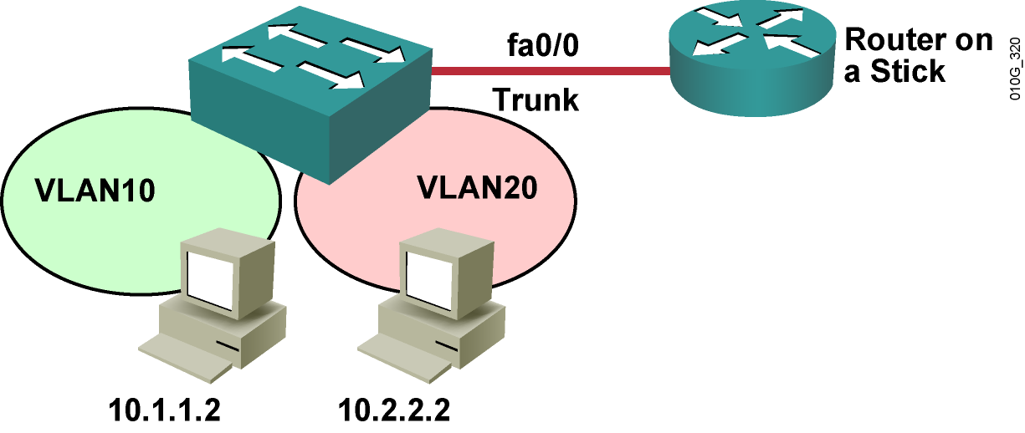
Inter-VLAN Routing with External Router
  Single trunk link carries traffic for multiple VLANs to and from router.
Notes:
Purpose: This slide discusses the solution of ISL.
Emphasize:
The Inter-Switch Link (ISL) protocol is used to inter-connect two VLAN-capable Fast Ethernet devices, such as the Catalyst 5000 or Cisco 7500 routers. The ISL protocol is a packet-tagging protocol that contains a standard Ethernet frame and the VLAN information associated with that frame.
ISL is currently supported over Fast Ethernet links, but a single ISL link, or trunk, can carry traffic from multiple VLANs.
The concept of ISL was discussed in the “Defining Common Workgroups” chapter. How to configure ISL links is discussed later in this chapter.
Discuss the example in the SG.
Transition: Following is a discussion of ISL links to single router.

Slide 3
Inter-VLAN Routing
External Router Configuration Commands
Configure on subinterface
  encapsulation dot1Q (or isl) 10
  ip address 10.10.1.1 255.255.255.0
Verify
  show vlan 10
  show ip route

Slide 4
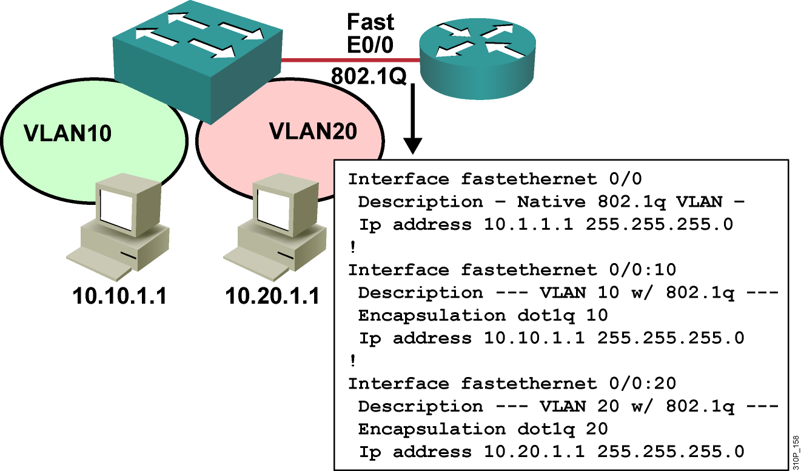
Inter-VLAN Routing on External Router:
802.1Q Trunk Link
Notes:
Purpose: This figure shows the configuration of the router on a stick.
Emphasize: Highlight the two different interconnecting networks, 10.1.1.0 and 10.2.2.0.

Slide 5
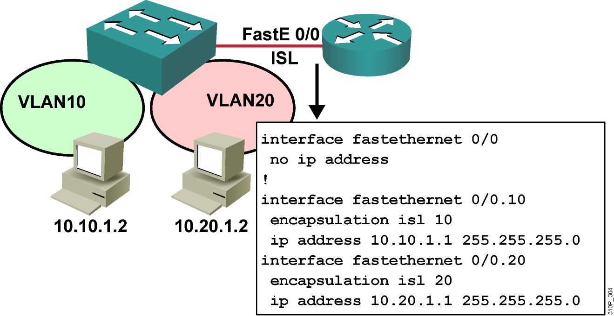
Inter-VLAN Routing on External Router:
ISL Trunk Link
Notes:
Purpose: This figure shows the configuration of the router on a stick.
Emphasize: Highlight the two different interconnecting networks, 10.1.1.0 and 10.2.2.0.

Slide 6
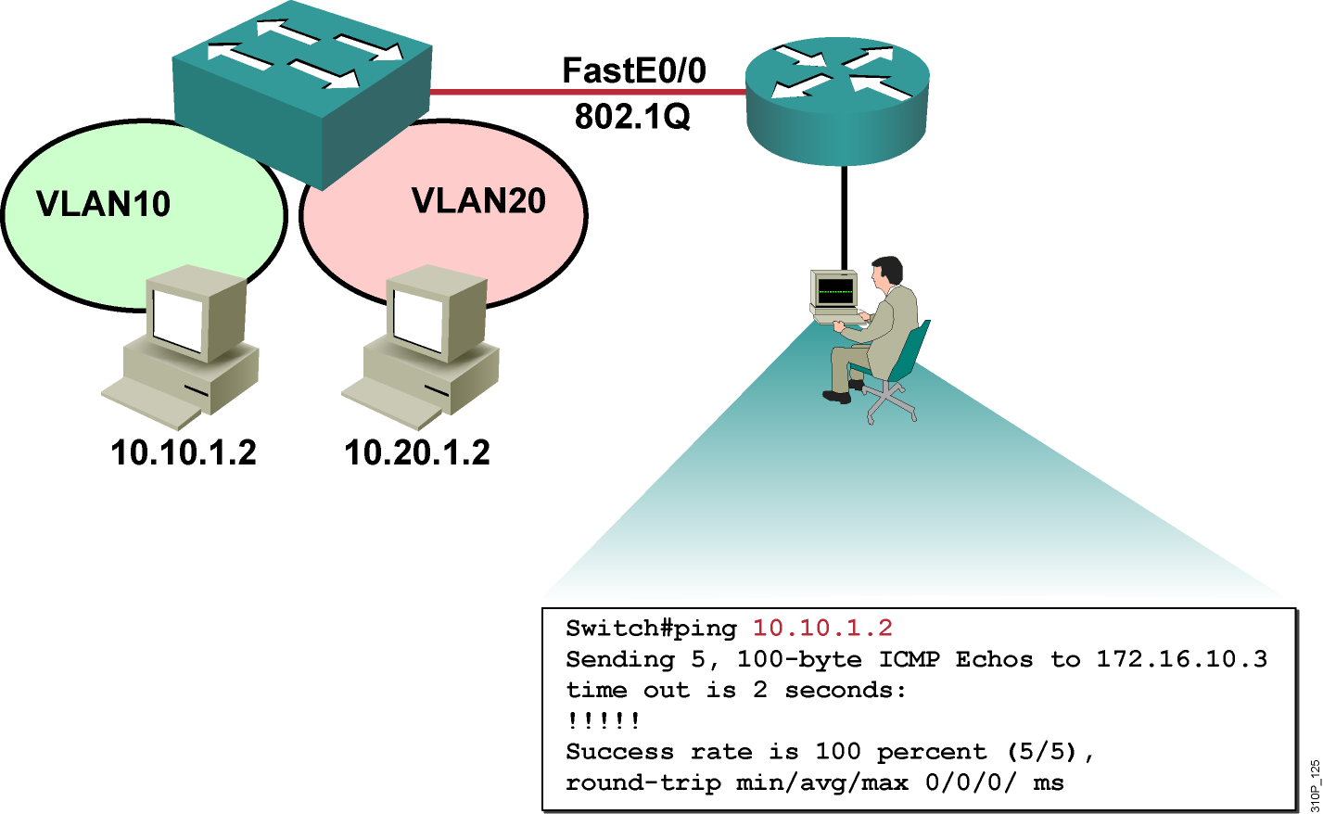
Verifying Inter-VLAN Routing
The ping command tests connectivity to remote hosts.
Notes:
Purpose: This slide discusses the ping command.
Emphasize: Use the ping command to test connectivity to remote hosts.
The ping command will return one of the following responses:
Success rate is 100 percent or ip address is alive. This response occurs in 1 to 10 seconds, depending on network traffic and the number of ICMP packets sent.
Destination does not respond. No answer message is returned if the host does not
Unknown host. This response occurs if the targeted host does not exit
Destination unreachable. This response occurs if the default gateway cannot reach the specified network
Network or host unreachable. This response occurs if there is no entry in the route table for the host or network.
You can also test the routes packets will take from the route processor to a specific destination by using the trace ip destination command.
For more information on the trace ip command, refer to the Cisco IOS Release 12.0 Command Summary .
Transition: Following is the visual for the laboratory exercise.

Slide 7
Verifying the Inter-VLAN Routing Configuration
Router#show vlan
Displays the current IP configuration per VLAN
Router#show ip route
Displays IP route table information
Router#show ip interface brief
Displays IP address on interfaces and current state of interface

Slide 8
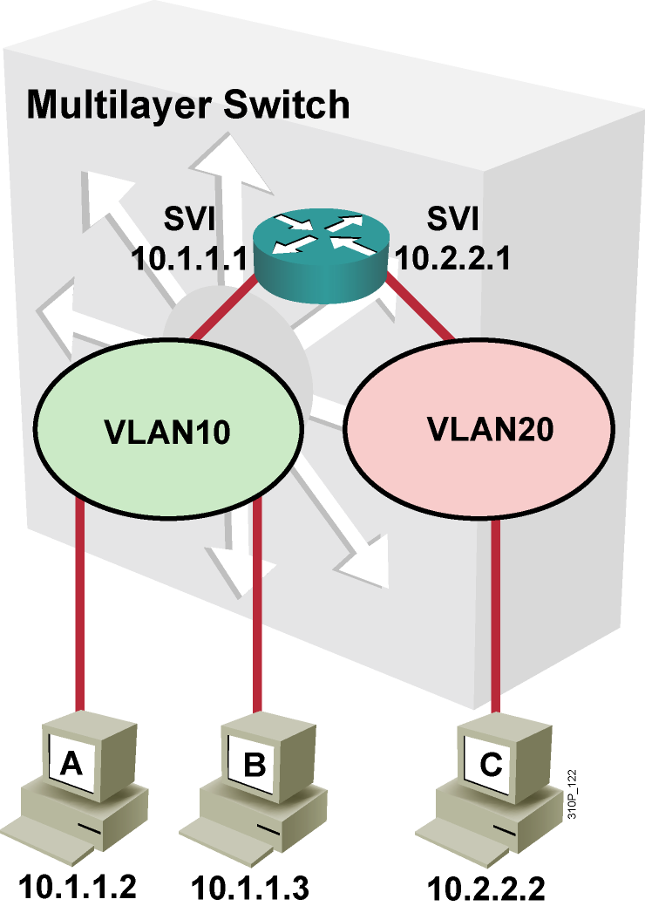
Layer 3 SVI

Slide 9
SVI on a Multilayer Switch
Configure
  ip routing
  interface vlan 10
    ip address 10.1.1.1 255.255.255.0
Verify
  show ip route

Slide 10
Configuring Inter-VLAN Routing
Through an SVI
Step 1: Configure IP routing.
Switch(config)#ip routing
Step 2: Create an SVI interface.
Switch(config)#interface vlan vlan-id
Step 3: Assign an IP address to the SVI.
Switch(config-if)#ip address ip-address mask

Slide 11
Configuring DHCP

Slide 12
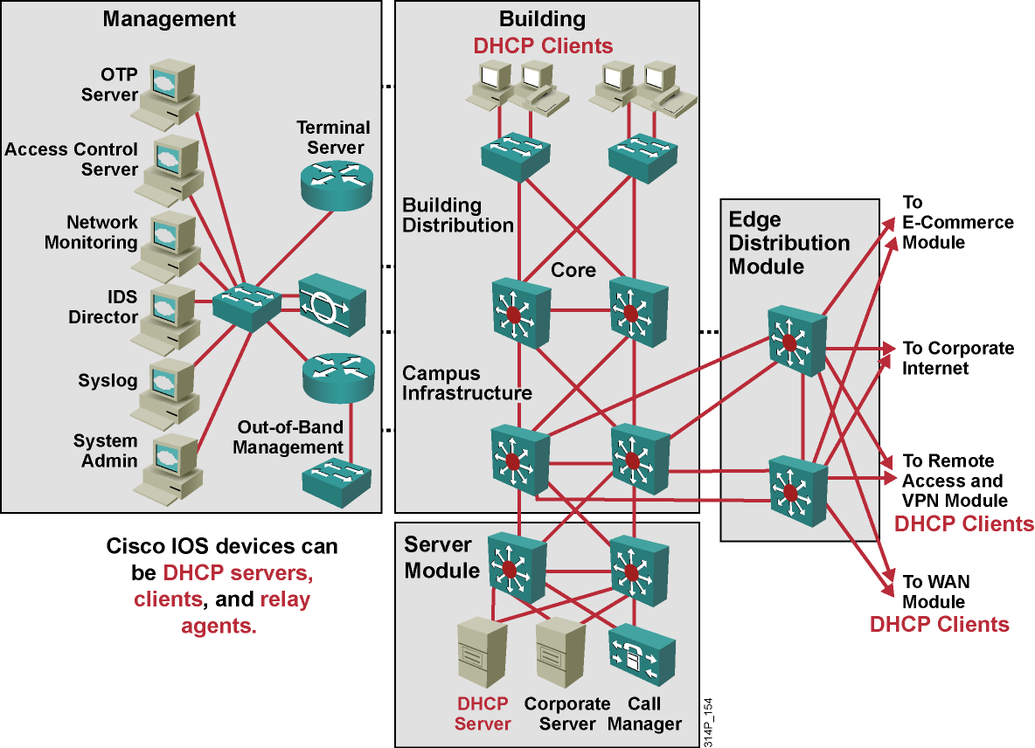
DHCP in an Enterprise Network

Slide 13
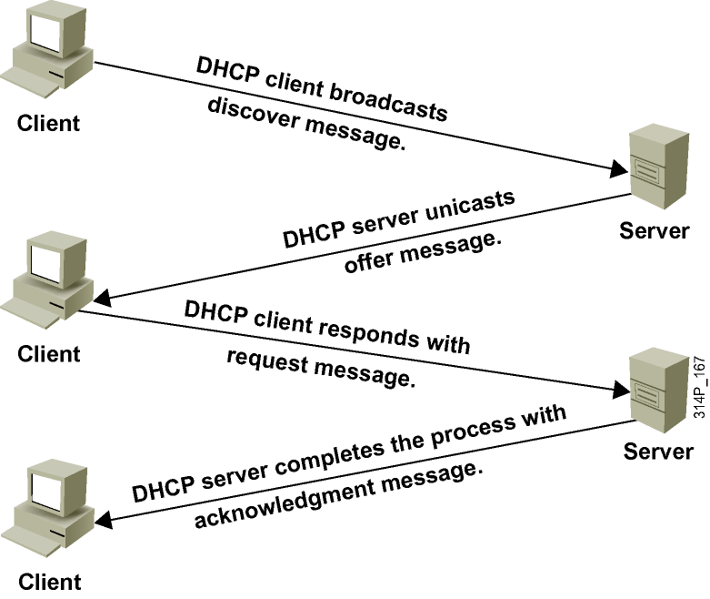
Dynamic Host Configuration Protocol
Notes:
UDP port 67, 68
Layer 4:
Source port: 68
Destination port: 67
Layer 3:
S.IP 0.0.0.0
D.IP 255.255.255.255
Layer 2:
S.MAC: MAC NIC
D.MAC : ffff.ffff.ffff

Slide 14
Configuring a DHCP Server
Router(config)#ip dhcp pool [pool name]
Enables a DHCP pool for use by hosts
Router(config-dhcp)#network [network address][subnet mask]
Specifies the network and subnet mask of the pool
Router(config-dhcp)#default-router [host address]
Specifies the default router for the pool to use
Notes:
Purpose: This figure shows the commands used to allocate the number of channels (timeslots) to a PRI group, specify which serial port will be the D channel, and allow analog calls to terminate on internal modems.
Emphasize: The serial interface slot/port or unit number will be the slot/port or unit number of the T1/E1 controller. The isdn incoming-voice modem command allows analog calls over a PRI to terminate on internal modems. The router uses the bearer capability field in the ISDN Q.931 message to indicate whether the call is analog (voice) or digital, and then switches it appropriately.
Transition: The next figure shows an example ISDN PRI configuration.

Slide 15
DHCP Server Configuration Example
ip dhcp excluded-address 172.16.1.100 172.16.1.103
ip dhcp excluded-address 172.16.2.100 172.16.2.103
ip dhcp pool LAN
network 172.16.0.0/16
domain-name global.com
dns-server 172.16.1.102 172.16.2.102
netbios-name-server 172.16.2.103 172.16.2.103
default-router 172.16.1.100
Notes:
Purpose: This figure shows an example ISDN PRI configuration.
Emphasize: Review the commands.
Transition: The next figure shows the lab configuration topology.

Slide 16
DHCP Client
Router(config-if)# ip address dhcp
Enables a Cisco IOS device to obtain an IP address dynamically from a DHCP server
Notes:
Purpose: This figure shows an example ISDN PRI configuration.
Emphasize: Review the commands.
Transition: The next figure shows the lab configuration topology.

Slide 17
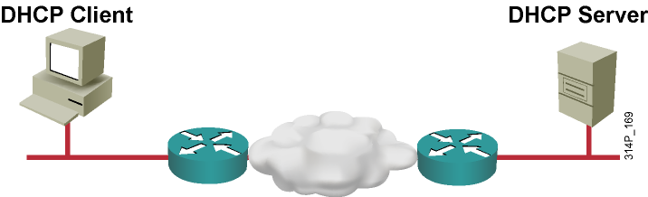
Helper Addressing Overview
  Routers do not forward broadcasts, by default.
  Helper address provides selective connectivity.

Slide 18
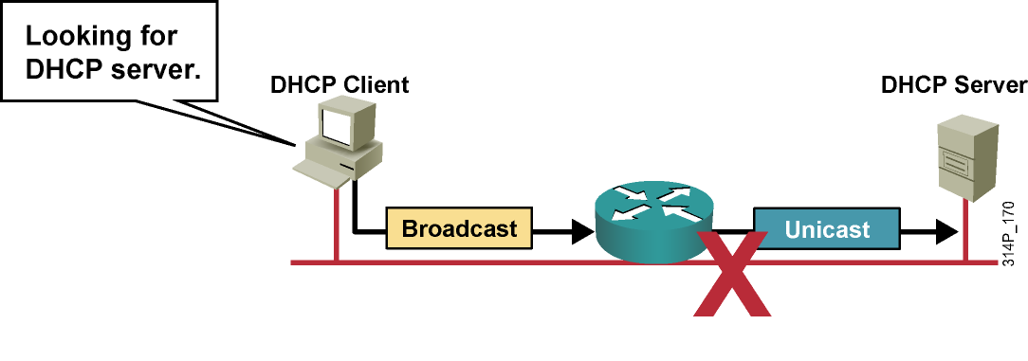
Why Use a Helper Address?
  Sometimes clients do not know the server address.
  Helpers change broadcast to unicast to reach server.

Slide 19
IP Helper Address Commands
Router(config-if)# ip helper-address address
Enables forwarding and specifies destination address for main UDP broadcast packets
Changes destination address from broadcast to unicast or directed broadcast address

Slide 20
DHCP Verification Commands
Router# show ip dhcp database
Displays recent activity on the DHCP database
Router# show ip dhcp server statistics
Shows count information about statistics and messages sent and received
Router# show ip route dhcp
Displays routes added to the routing table by DHCP
Router# debug ip dhcp server {events|packets|linkage}
Enables debugging on the DHCP server

